Slide 1
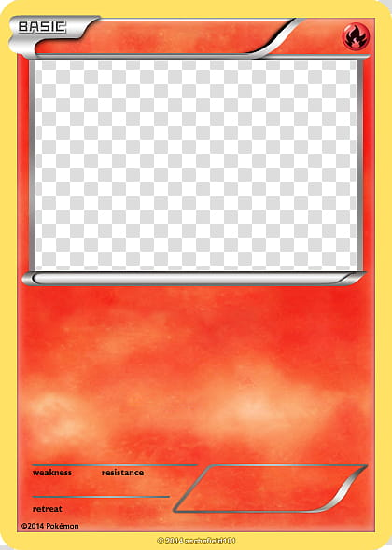
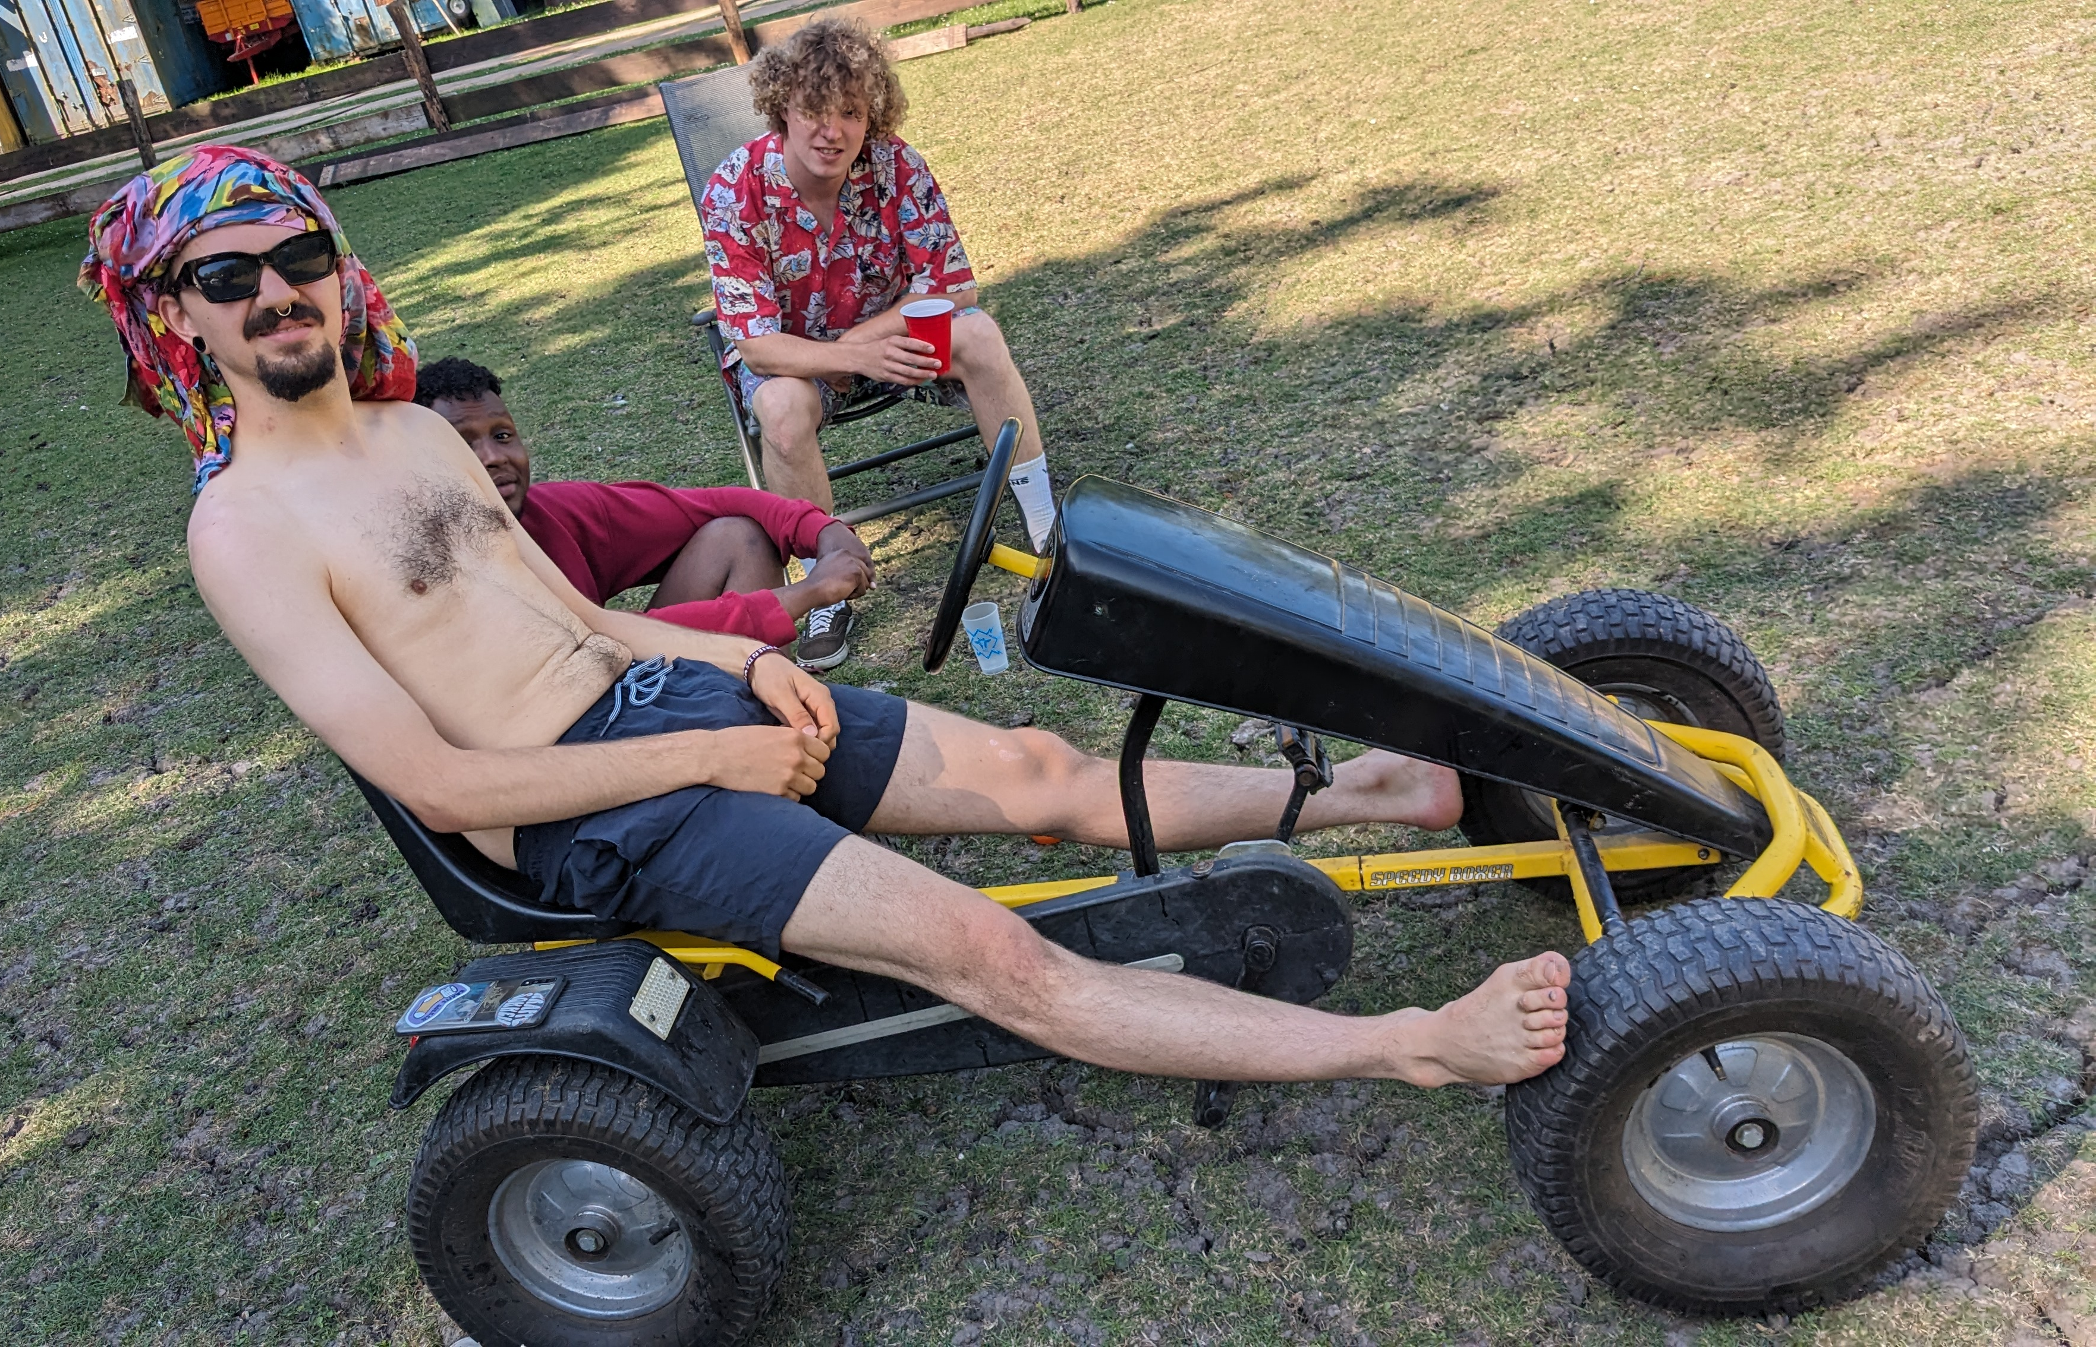



Mosselmobiel
Baslick boost
120
Red wine landmine
69
Curry Blurry
30
When multiple mossels gather, a distinct sea smell will rise up in the air
Kater
💅🏼💅🏼💅🏼💅🏼💅🏼💅🏼
Schagen city

